Slide 1
Ukraine-2014: new reality
Iryna Bekeshkina
Ilko Kucheriv Democratic Initiatives Foundation, Kyiv

Slide 2
Does “Novorossiya” want to join Russia?
Regional differences in answers to question “Do you want your region to secede from Ukraine and join other country?” (May – September 2014, Ilko Kucheriv Democratic Initiatives Foundation, Kyiv International Institute of Sociology)
No
Yes

Slide 3
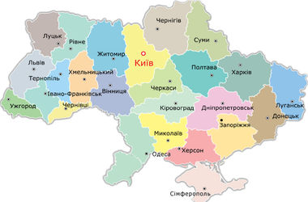
Does “Novorossiya” want federalization?
Which form of territorial organization, in your opinion, should Ukraine have?
(Ilko Kucheriv Democratic Initiatives Foundation,
Kyiv International Institute of Sociology)
 | West | Center | South | East | Donbas | Ukraine
Unitary, with regions having the same rights as now | 23.7 | 32.1 | 34.4 | 27.7 | 6.6 | 25.4
Unitary, but decentralized, with enhanced rights of regions | 61.4 | 48.8 | 46.9 | 40.3 | 30.0 | 46.7
Federative | 1.3 | 3.5 | 6.0 | 16.3 | 38.8 | 11.4
Difficult to say | 13.6 | 16.3 | 12.8 | 15.7 | 24.6 | 16.5

Slide 4
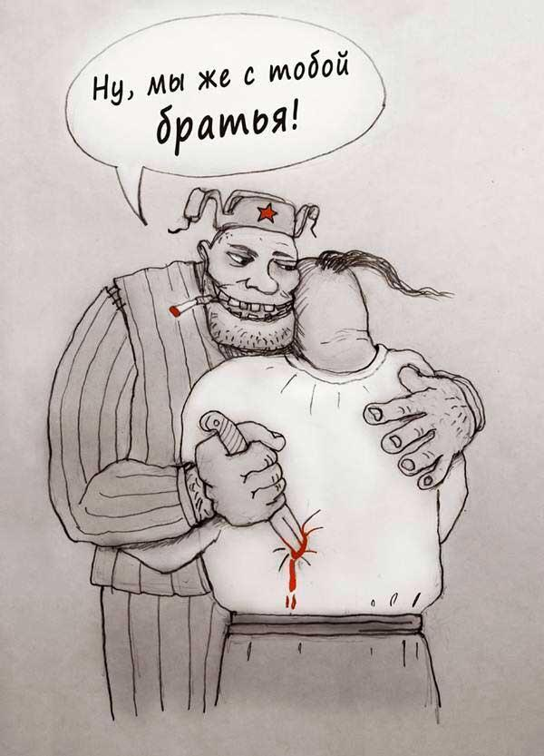
Ukrainians and Russians see the events in Donbas differently
Do you agree with the statement that Russia actively supports pro-Russian forces in the East of Ukraine?
(Data from Russia – Levada Center;
Data from Ukraine - Ilko Kucheriv Democratic Initiatives Foundation, Kyiv International Institute of Sociology)

Slide 5
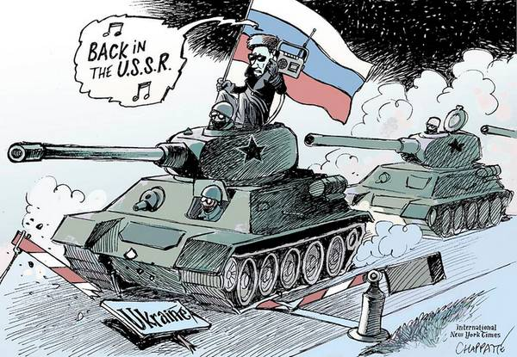
Ukrainians and Russians see the events in Donbas differently
Do you agree with the statement that there is war between Russia and Ukraine?
(Data from Russia – Levada Center;
Data from Ukraine - Ilko Kucheriv Democratic Initiatives Foundation, Kyiv International Institute of Sociology)

Slide 6
Ukrainians and Russians see the events in Donbas differently
Do you agree with the statement that Russia is responsible for bloodshed and deaths in the East of Ukraine?
(Data from Russia – Levada Center;
Data from Ukraine - Ilko Kucheriv Democratic Initiatives Foundation, Kyiv International Institute of Sociology)

Slide 7
In all regions, except Donbas, population considers Russia responsible for bloodshed in the East
Do you agree with the statement that Russia is responsible for bloodshed and deaths in the East of Ukraine?
 | West | Center | South | East | Donbas
Definitely yes | 66,3 | 55,3 | 40,5 | 30,9 | 7,3
Rather yes | 15,3 | 22,2 | 25,7 | 19,4 | 11,8
Rather no | 5,3 | 8,6 | 7,1 | 14,4 | 16,7
Definitely no | 10,5 | 4,6 | 7,6 | 26,1 | 46,1
Difficult to say | 2,6 | 9,2 | 19,0 | 9,3 | 18,2

Slide 8
Ukrainians and Russians see the events in Donbas differently
Which option of future status of Donetsk and Luhansk regions do you prefer?
(Data from Russia – Levada Center;
Data from Ukraine - Ilko Kucheriv Democratic Initiatives Foundation, Kyiv International Institute of Sociology)

Slide 9
Russian started to treat Ukrainians – as well as Ukrainians started to treat Russians – worse. Still, Russians have more negative attitude towards Ukrainians
Dynamics of positive attitude of Ukrainians towards Russians and Russians towards Ukrainians

Slide 10
Majority of Donbas populations sees Donbas inside Ukraine, but with more autonomy. West and Center do not agree to more autonomy for Donbas
Which option of future status of Donetsk and Luhansk regions do you prefer?
 | West | Center | South | East | Donbas
Donbas will remain a part of Ukraine, with the same rights as before | 73,9 | 52,9 | 35,1 | 39,1 | 7,3
Donbas will remain a part of Ukraine, but with more autonomy from Kyiv | 18,4 | 32,0 | 33,2 | 40,2 | 42,4
Donbas (DPR and LPR) will become an independent state | 0,7 | 1,4 | 7,7 | 7,2 | 25,9
Donbas will become a part of the Russian Federation | 2,4 | 2,4 | 2,4 | 5,3 | 16,2
Difficult to say | 4,5 | 11,2 | 21,6 | 8,2 | 8,2

Slide 11
In Ukrainians’ public view, Eastern foreign vector is no longer on a same part as Western
Positive attitudes towards joining union with Russia and Belarus and towards joining the EU
(Data of the Institute of Sociology of the National Academy of Sciences of Ukraine)

Slide 12
Support of EU membership dominates in all regions, except Donbas
Popular attitudes towards EU membership
 | West | Center | South | East | Donbas | Ukraine
Positive | 75 | 68 | 38 | 37 | 11 | 51
Negative | 7 | 9 | 31 | 33 | 63 | 24
Difficult to say | 17 | 23 | 31 | 30 | 26 | 25

Slide 13
Ukrainians have changed their opinion on NATO and started to see it as a guarantor of security
Which option of foreign security policy, in your opinion, is best for Ukraine?
(Ilko Kucheriv Democratic Initiatives Foundation,
Kyiv International Institute of Sociology)

Slide 14
Popular attitudes towards NATO vary in different regions
Which option of foreign security policy, in your opinion, is best for Ukraine?
 | West | Center | South | East | Donbas
Joining the NATO | 78,3 | 52,7 | 24,8 | 32,4 | 5,7
Military union with Russia and other CIS countries | 1,4 | 3,2 | 14,8 | 23,9 | 45,5
Non-alighed status of Ukraine | 6,9 | 17,9 | 36,7 | 23,7 | 39,8
Other | 0,0 | 0,1 | 1,9 | 0,5 | 0,3
Difficult to say | 13,4 | 26,1 | 21,9 | 19,4 | 8,7

Slide 15
In Ukraine, national self-identification has grown
Who do yourself consider in the first place?
 | July 2013 | July 2014
An inhabitant of my village/town/city | 29 | 16
An inhabitant of my region | 8 | 8
A citizen of Ukraine | 51 | 65
A representative of my ethnos | 2 | 2
A citizen of the USSR | 7 | 5
A citizen of Europe | 1 | 1
A citizen of the world | 2 | 2
Other | 1 | 1

Slide 16
Identification with Ukrainian citizenship dominates in all regions, except Donbas
 | West | Center | South | East | Donbas | Ukraine
An inhabitant of my village/town/city | 14 | 14 | 25 | 14 | 18 | 16
An inhabitant of my region | 7 | 2 | 5 | 5 | 27 | 8
A citizen of Ukraine | 70 | 76 | 59 | 67 | 34 | 65
A representative of my ethnos | 3 | 2 | 1 | 3 | 1 | 2
A citizen of the USSR | 0 | 3 | 6 | 9 | 14 | 5
A citizen of Europe | 3 | 1 | 1 | 1 | 1 | 1
A citizen of the world | 1 | 1 | 3 | 2 | 5 | 2
Other | 1 | 1 | 0 | 0 | 1 | 1

Slide 17
Expected turnout on 2014 parliamentary elections
The highest turnout on the forthcoming parliamentary elections is expected in Western and Central regions in Ukraine, somewhat smaller – in Southern and Eastern regions, and marginally low – in Donbas.
(Ilko Kucheriv Democratic Initiatives Foundation,
Kyiv International Institute of Sociology)

Slide 18
In the next parliament, Petro Poroshenko Block will be the dominant force; Eastern region will be underrepresented
 | % of those who are going to vote
Petro Poroshenko Block (Lutsenko) | 29,9
“Batkivshchyna” (Tymoshenko) | 8,7
Oleh Liashko Radical Party | 7,6
“Civic position” (Hrytsenko) | 7,3
“People’s Front” (Yatseniuk) | 7,0
Less than 5%
“Svoboda” (Tiahnybok)
Communist Party of Ukraine (Symonenko)
“Strong Ukraine” (Tihipko)
Union “Samopomich” (Sadovyi)
“Pravyi Sector” (Yarosh)

